Slide 1



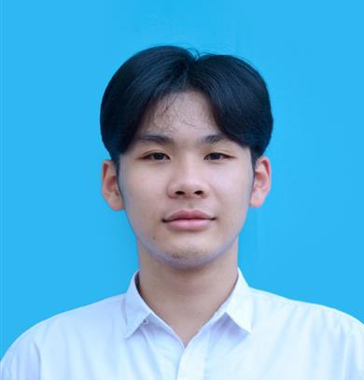
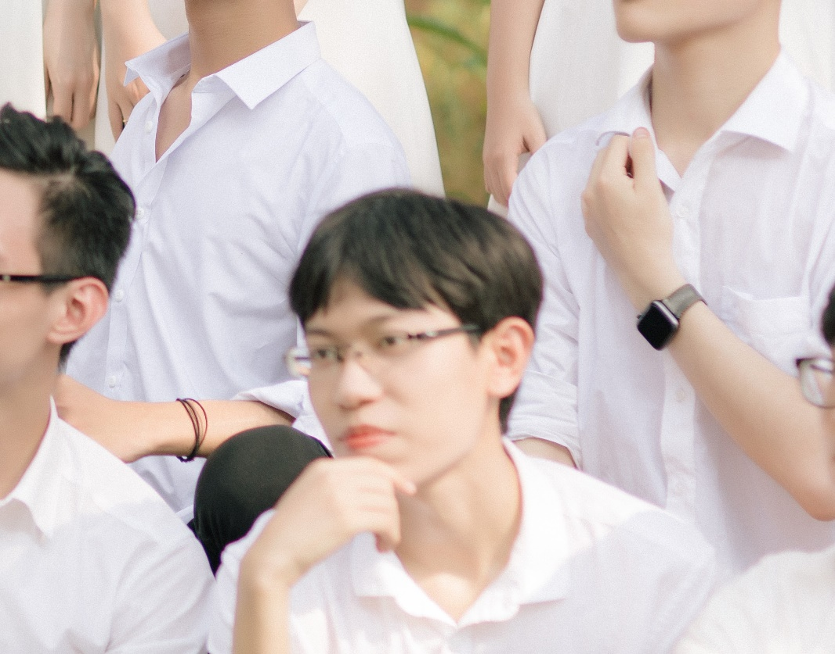
GROUP 06
CONTROLLER
Model
vIEW
Le Hong Duc 20204874
Nguyen Cong Dat 20200137

Slide 2

PROBLEM STATEMENT
PROBLEM
design
Implement an application that provides GUI for the user to virtually play an electronic piano.
Design a UI with keyboard, volume, record, music style, ... that comfort users.

Slide 3

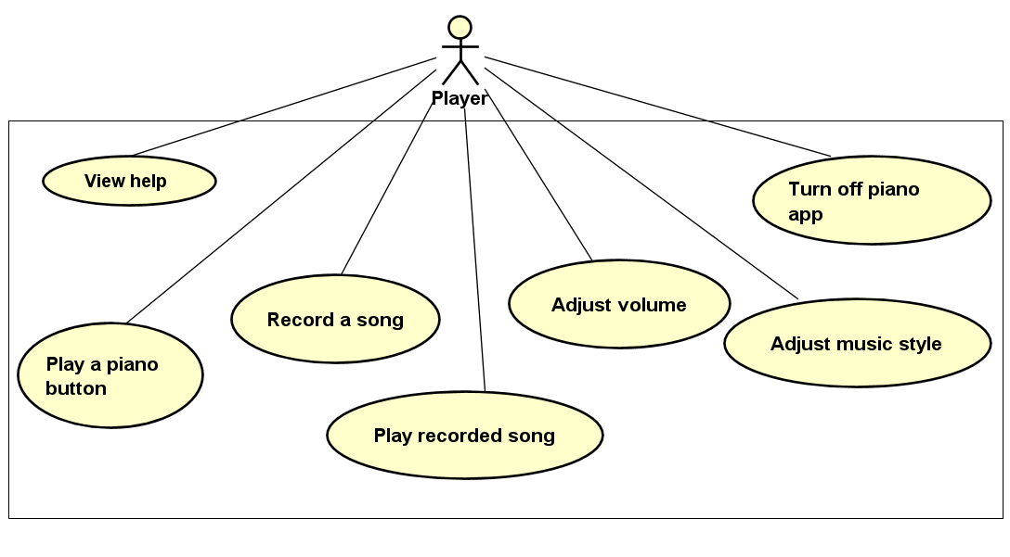
USE CASE DIAGRAM
User can start to play by clicking, pressing or editing the song themself
Play a note whenever user touches.
Notice the user if a key on keyboard cannot play.
Replay everything we've just played.
Adjust volume, music style for different experiences.
User can view help menu.
User can confirm to exit from the program.

Slide 4
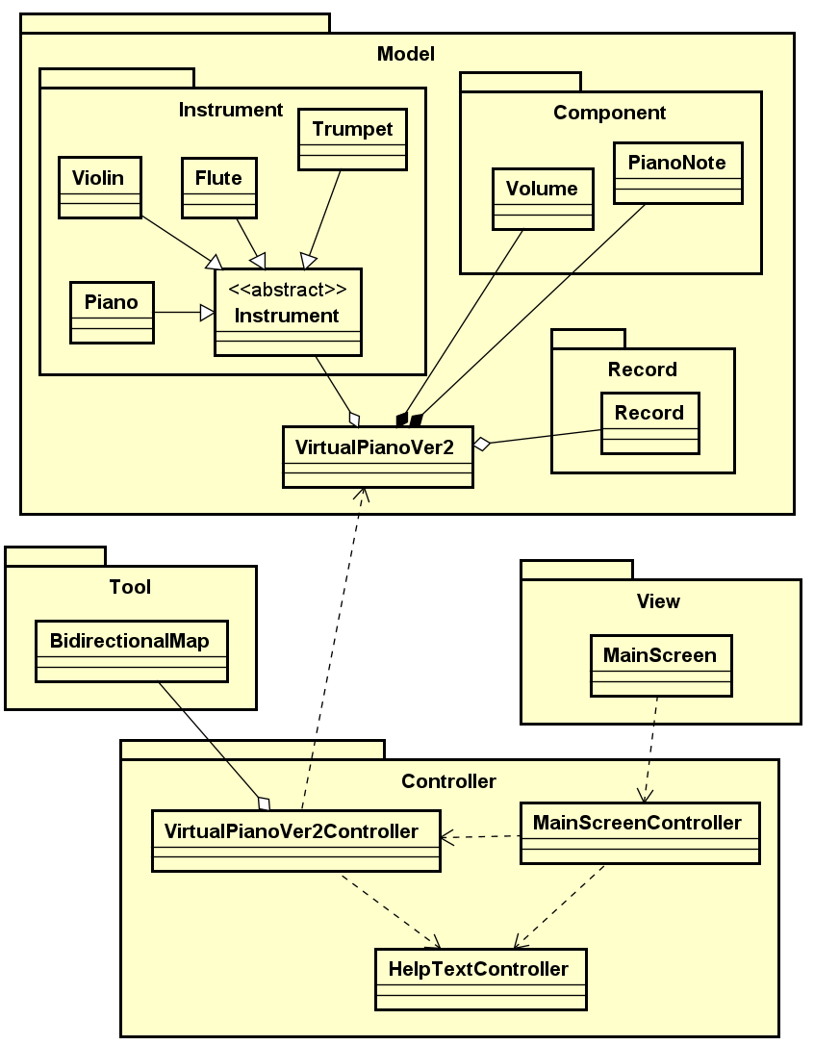
Class DIAGRAM
Package “Model”: store a complete piano
Package “Controllers”: store all the screen controllers.
Package “View”: store the “MainScreen” class of the application.
Package “Tool”: store key character and corresponding piano note,

Slide 5
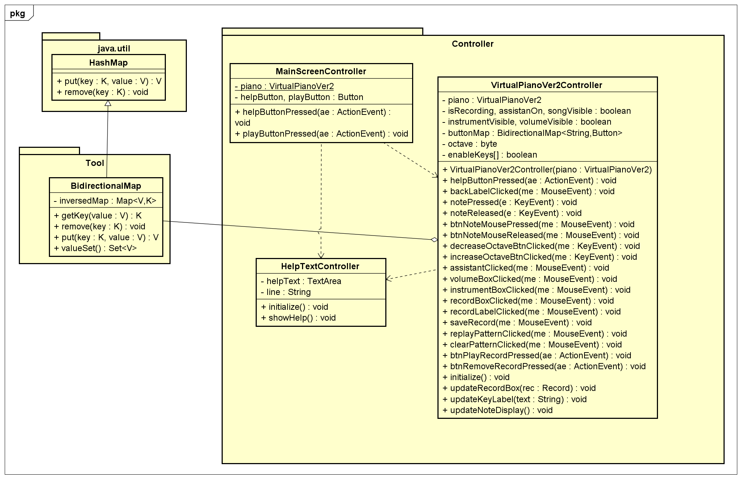
Package

Slide 6
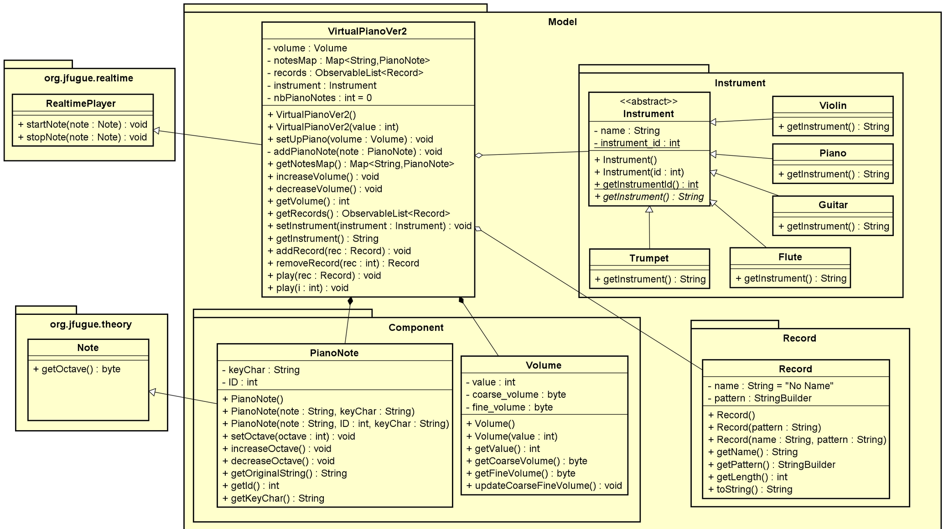

Slide 7


Encapsulation
Abstraction
Package Model, class VirtualPianoVer2
Package Controller, class VirtualPianoVer2Controller use instance of BidirectionalMap
Package Instrument in package model, 5 class implement abstract method from abstract class Instrument

Slide 8
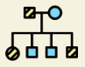

Inheritance
Polymorphism
Package Tool, BidirectionalMap class inherits from HashMap and implements all of the abstract methods.
All type of instruments (piano, violin, flute, …) are upcasting to Instrument class.

Slide 9
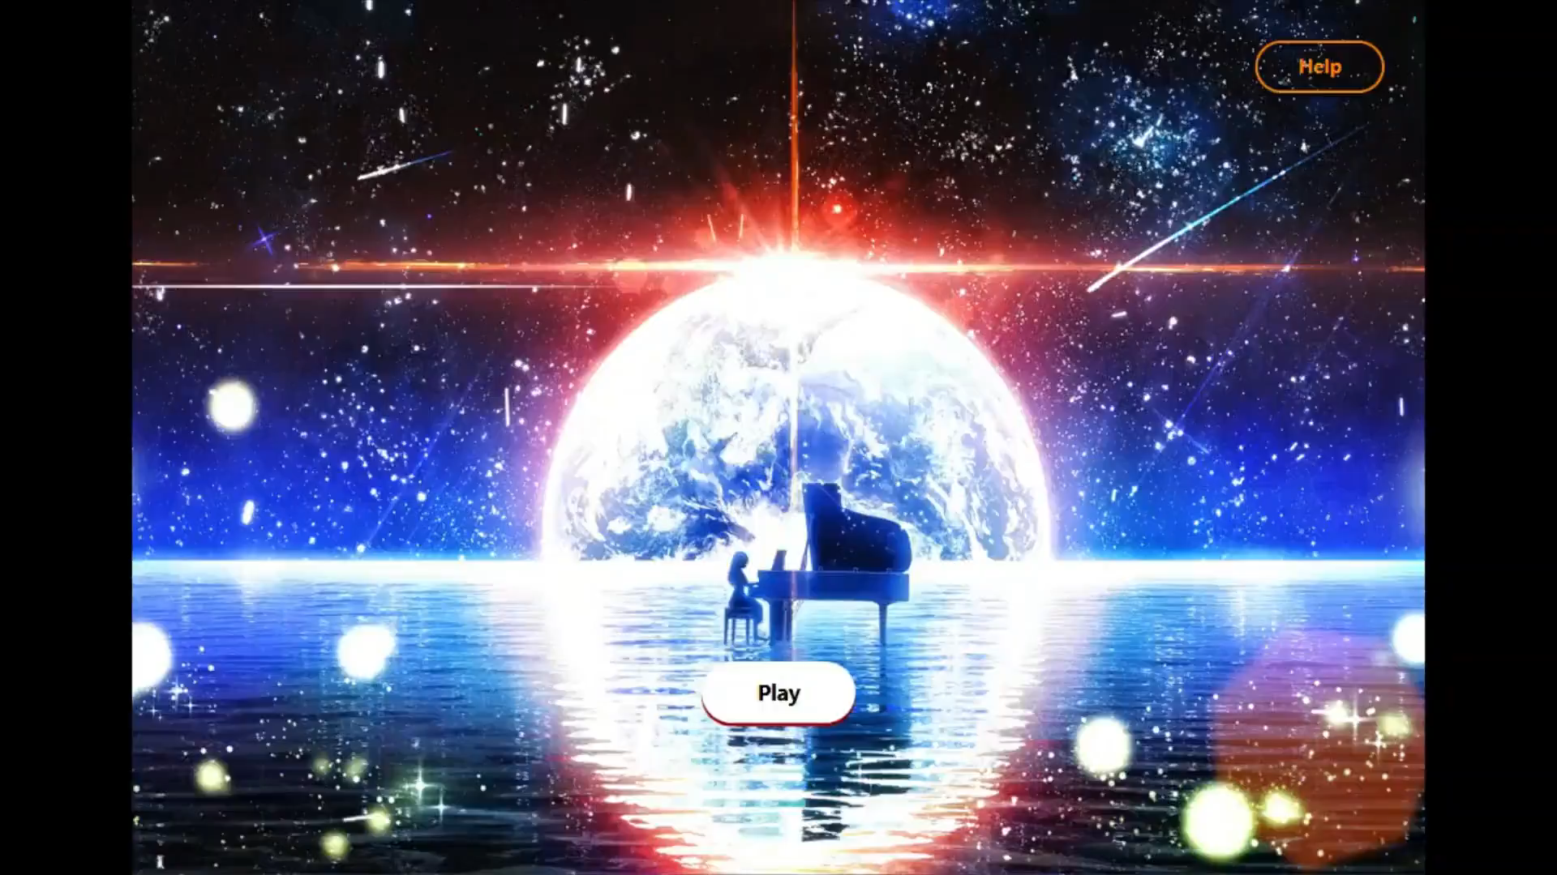
Demo

